Slide 1
Digital Thinking and Innovation CT109-3-1 VD1
Digital Security

Slide 2
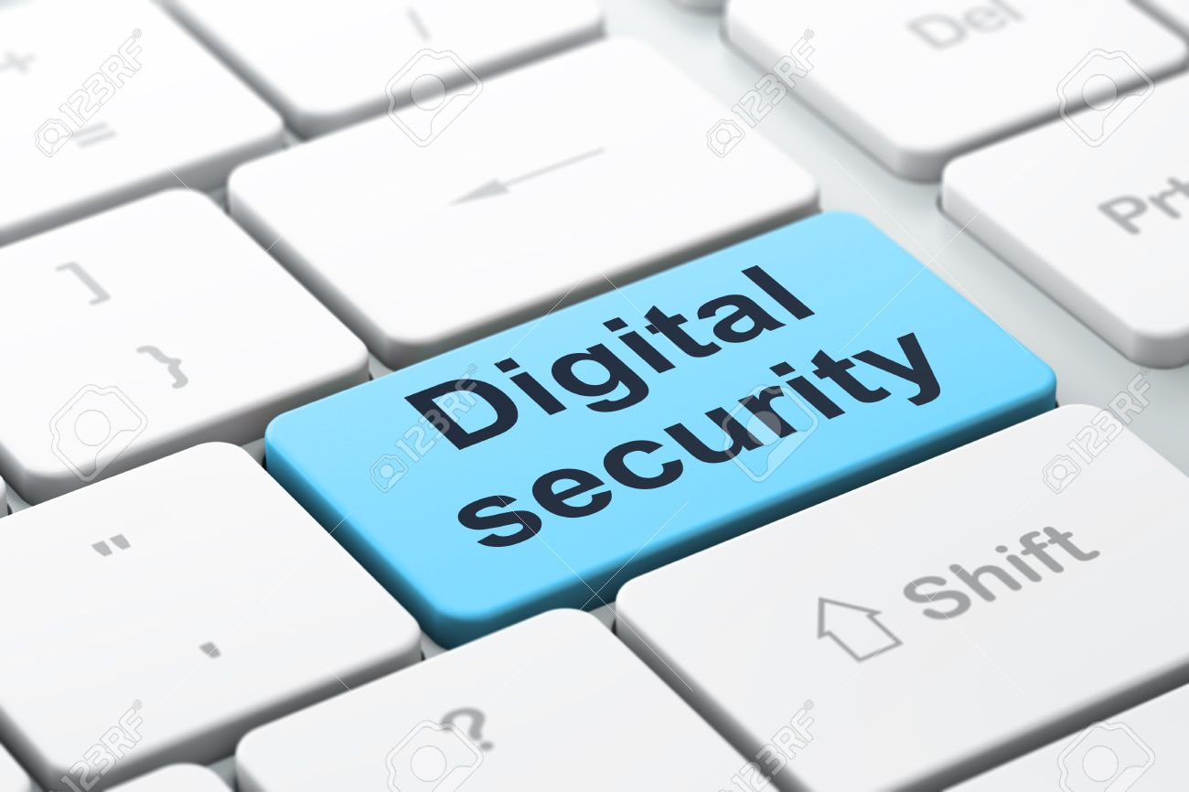
Introduction
This topic introduces digital security and the preventive methods

Slide 3
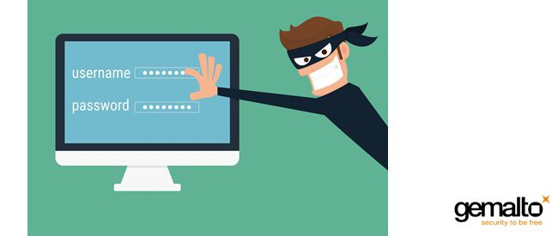
Learning Outcomes of the Lecture
At the end of this section you will be able to:
Define digital security risks and types of Malware
Describe types of Internet and network attacks and explain ways to safeguard against these attacks
Describe digital signatures and digital certificates

Slide 4
Content
Types of Digital Security Risks
Computer Crime, Cybercrime
Malware
System Failure
Digital Signature

Slide 5
Key Terms
Digital Security Risks
Computer Crime, Cybercrime
Malware
System Failure
Digital Signature

Slide 6
Mind Map
Digital Security
System Failure
Malware
Digital Signature
Types of Digital Security Risks

Slide 7
Learning Outcomes of the Lecture
At the end of this section you will be able to:
Define digital security risks and types of Malware
Describe types of Internet and network attacks and explain ways to safeguard against these attacks
Describe digital signatures and digital certificates

Slide 8
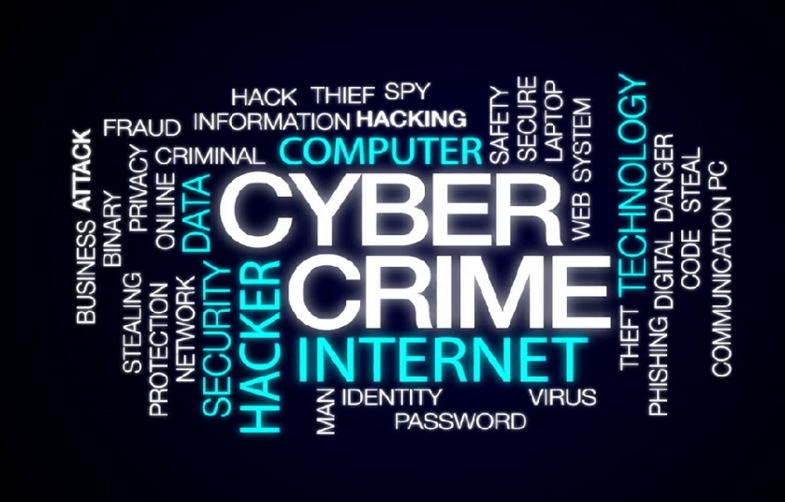
Digital Security Risk
Digital Security Risk - an event that could cause loss of or damage to a computer or mobile device hardware, software, data, information or processing capability
Computer Crime - any illegal act involving the use of a computer or related devices
Cybercrime – online or Internet-based illegal act
Information transmitted over
networks has a higher
degree of security risk than
information kept in
organizations

Slide 9
Malicious Software (Malware)
Virus is a potentially damaging computer program
Worm copies itself repeatedly, using up resources and possibly shutting down computer or network
Trojan Horse hides within or looks like legitimate program until triggered
Payload (destructive event) that is delivered when you open file, run infected program or boot computer with infected disk in disk drive
Can spread and damage files
Does not replicate itself on other computers

Slide 10
Learning Outcomes of the Lecture
At the end of this section you will be able to:
Define digital security risks and types of Malware
Describe types of Internet and network attacks and explain ways to safeguard against these attacks
Describe digital signatures and digital certificates

Slide 11
Internet and Network Attacks
Type | Description
Adware | A program that displays an online advertisement in a banner, pop-up window, or pop-under window on webpages, email messages, or other Internet services.
Ransomware | A program that blocks or limits access to a computer, phone, or file until the user pays a specified amount of money.
Rootkit | A program that hides in a computer or mobile device and allows someone from a remote location to take full control of the computer or device.
Spyware | A program placed on a computer or mobile device without the user’s knowledge that secretly collects information about the user and then communicates the information it collects to some outside source while the user is online.
Trojan Horse | A program that hides within or looks like a legitimate program. Unlike a virus or worm, a trojan horse does not replicate itself to other computers or devices.
Virus | A potentially damaging program that affects, or infects, a computer or mobile device negatively by altering the way the computer or device works without the user’s knowledge or permission.
Worm | A program that copies itself repeatedly, for example in memory or on a network, using up resources and possibly shutting down the computer, device, or network.

Slide 12
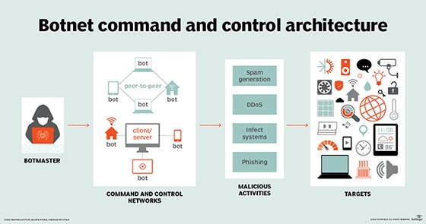
Internet and Network Attacks
Botnet - group of compromised computers or mobile devices connected to a network
Zombie PC - compromised computer or device
Denial of service attack (DoS) - disrupts computer access to an Internet service
Distributed DoS attack (DDoS attack) – larger scale of a DoS
Backdoor - program or set of instructions in a program that allow users to bypass security controls

Slide 13
Internet and Network Attacks
DoS attack
An assault to disrupt computer access to the Internet e.g. Web or email
Hacker uses unsuspecting computer, called zombie, to send an influx of confusing data messages to execute attack on other systems
Distributed DoS (DDoS) attack is more devastating, extensive in which multiple computers attack multiple networks. Websites that have been affected: Yahoo! eBay, Amazon.com, CNN.com
Computer Emergency Response Team Coordination Center (CERT/CC) assists with DDoS attacks
p. 587

Slide 14
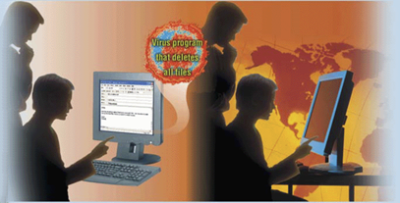
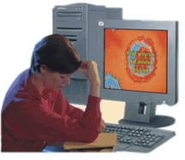
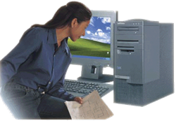
Attack with Virus
Step 1. Unscrupulous programmers create a virus program. They hide the virus in a Word document and attach the Word document to an e-mail message.
Step 2. They use the Internet to send the e-mail message to thousands of users around the world.
Step 3a. Some users open the attachment and their computers become infected with the virus.
Step 3b. Users who do not recognize the name of the sender of the e-mail message do not open the e-mail message. Instead they delete the e-mail message. These users’ computers are not infected with the virus.

Slide 15
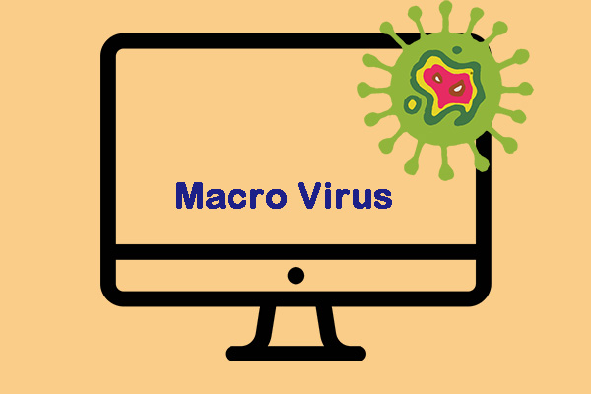
Macro Virus
Macro virus – malicious code written in word programs
Protection -
Set macro security level in applications that allow you to write macros
At medium security level warning displays that a document contains macro
Macros - instructions saved in an application, such as word processing or spreadsheet program

Slide 16
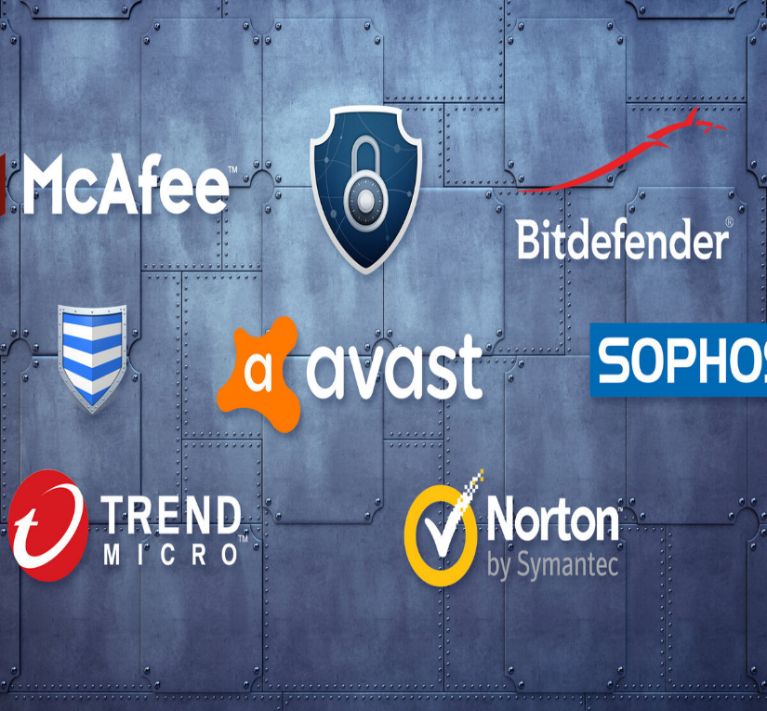
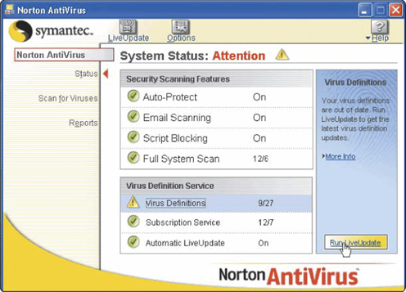
Antivirus
Antivirus software was originally developed to detect and remove computer viruses
Also protects against worms and Trojan horses

Slide 17
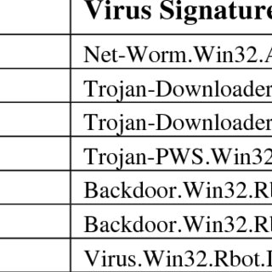
Virus Signature
Specific pattern of virus code
The binary pattern of the machine code of a particular virus
Also called virus definition
Antivirus programs look for virus signatures to identify the presence of a virus

Slide 18
How Antivirus Inoculates
Uses information to detect if virus has tampered any files
Records information about the
files such as file size and creation
Attempts to remove any detected virus
Quarantines infected files that it cannot remove
Keeps files in separate area of hard disk

Slide 19
Preventive Measures
1. Never start a computer with a removable media.
2. Set the macro security in programs so you can enable or disable macros
Install an antivirus program on all of your computers
Set the macro security to enable or disable macros
Never open e-mail attachment
unless it is from a trusted
source
If the antivirus program flags an e-mail attachment as infected, delete the attachment immediately
Check all downloaded programs for viruses, worms, or Trojan horses
1.Install a personal firewall program
2. Scan all removable media

Slide 20
Recaps
PLEASE DO QUIZ NO 1 – DIGITAL SECURITY
[Go to Moodle, click
“Formative Assessment” folder, then click
“Quiz No 1 – Digital Security” link

Slide 21
System Failure
Prolonged malfunction of computer
Can cause loss of hardware, software or data
Caused by aging hardware, natural disasters, or electrical power disturbances
Noise—unwanted electrical signal
Overvoltage or power surge— significant increase in electrical power
Undervoltage—drop in electrical supply

Slide 22
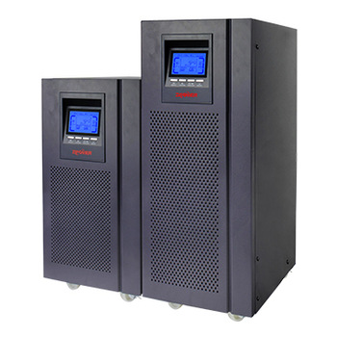
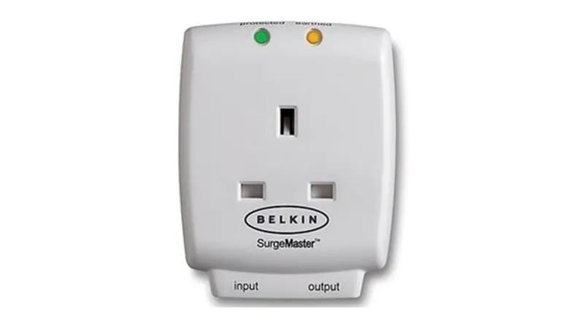
Surge Protector
Protects computer and equipment from electrical power disturbances
Uninterruptible power supply (UPS) - surge protector that provides power during power loss

Slide 23
Learning Outcomes of the Lecture
At the end of this section you will be able to:
Define digital security risks and types of Malware
Describe types of Internet and network attacks and explain ways to safeguard against these attacks
Describe digital signatures and digital certificates

Slide 24
Digital Signature
Digital Signature – encrypted code that a software attaches to an electronic message to verify the identity of the message sender
Secure site is Web site that uses encryption to secure data
Many Web browsers use encryption
Digital certificate is a notice that guarantees a user or website is legitimate

Slide 25
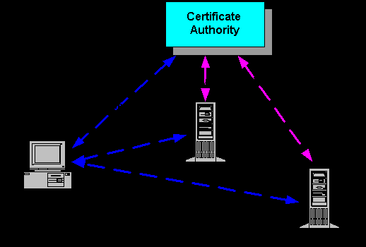
Certificate Authority (CA)
Authorized company issues and verifies digital certificates
Users apply for digital certificate from CA
Stores info such as user’s name, issuing CA’s name/signature, serial number of the certificate
Digital certificate is encrypted

Slide 26
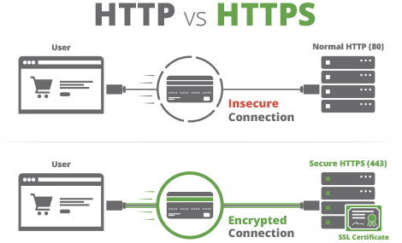
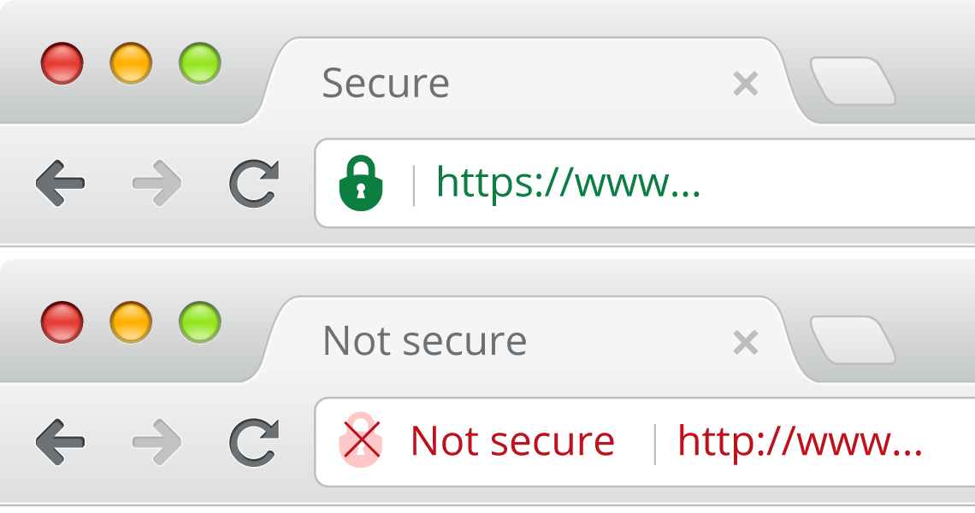
Secure Socket Layer (SSL)
Provides encryption of all data that passes between client and Internet server Web addresses beginning
with “https” indicate secure connections
Provides encryption and requires the client to have
a digital cert. Prevents illegal tampering of data

Slide 27
Backup
Backup – to duplicate file, program or disk
Full Backup backup ALL files in the computer
Selective Backup select which files to back up
In case of system failure or corrupted files, restore files by copying to original location

Slide 28
Disaster Recovery Plan
What is a disaster recovery plan?
Disaster Recovery Plan - written plan for restoring computer operations in the event of a disaster
Emergency Plan - steps to be taken immediately after disaster
Backup Plan - how backup files and equipment would be used to resume information processing
Recovery Plan - actions to be taken to restore full information processing operations
Test Plan - simulates various levels of disasters and records the ability to recover

Slide 29
Summary
Digital security risks and types of Malware
Types of Internet and network attacks and explain ways to safeguard against these attacks
Digital Signature and Digital Certificate
Backup

Slide 30
Review Questions
Explain digital security risks and types of Malware
Describe the types of Internet and network attacks and explain ways to safeguard against these attacks
Explain Digital signature and Digital certificate

Slide 31
Review Questions
Explain digital security risks and types of Malware
Digital Security Risk - an event that could cause loss of or damage to a computer or mobile device hardware, software, data, information or processing capability
Types of Malware
Adware, T Horse, Worms, Payload, Rootkit, Spyware

Slide 32
Review Questions
2. Describe the types of Internet and network attacks and explain ways to safeguard against these attacks
Internet and network attacks
1. Malware (TH, Worms, Adware, Rootkit, Backdoor, Ransomware, Micro Virus)
2. Botnet - group of compromised computers or mobile devices connected to a network
3. Zombie PC - compromised computer or device
4. Denial of service attack (DoS) - disrupts computer access to an Internet service5.
5. Distributed DoS attack (DDoS attack) – larger scale of a DoS
How to Safeguard
1. Never start from removable media
2. Install AV
3. Never open attachment from unknown email
4. Scan removable media
5. Install firewall

Slide 33
Review Questions
3. Explain digital signature and digital certificate
Digital signature
1. encrypted code that a software attaches to an electronic message to verify the identity of the message sender
Digital certificate
is a notice that guarantees a user or website is legitimate
Digital certificate is encrypted
User apply digital certificate from CA

Slide 34
Questions and Answer
Q & A

Slide 35
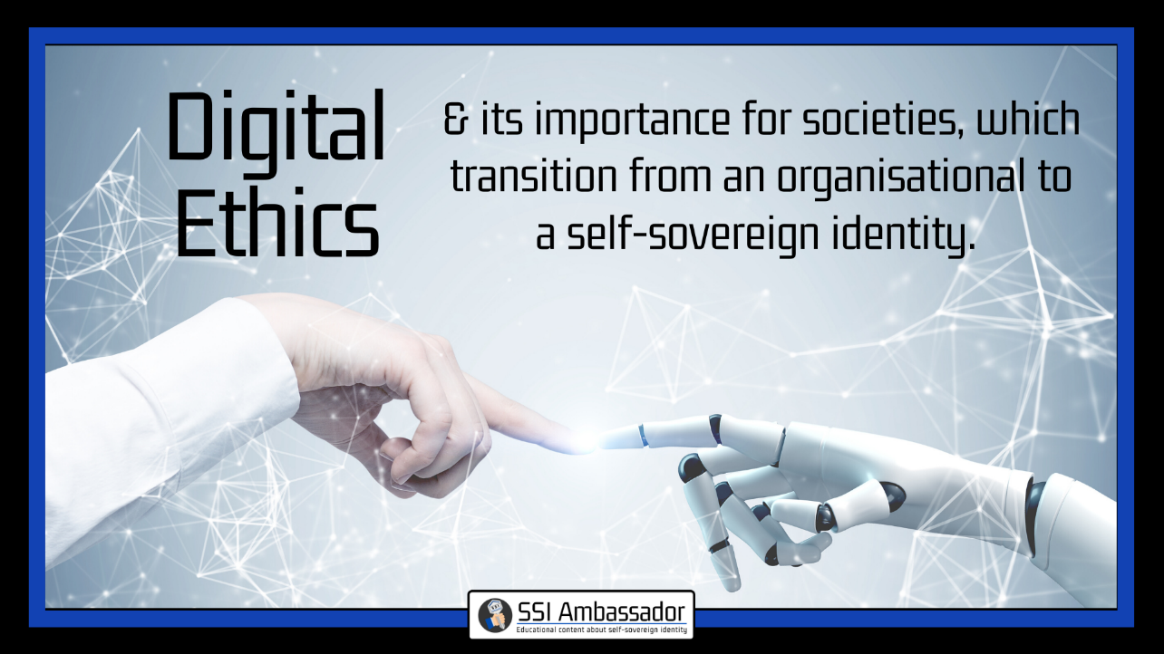
Next Lecture
Digital Ethics

